Slide 1
D A T A R E S E A R C H A N A L Y S T · F I N A L P R O J E C T
The Route to Profit
An Aviation Investment Analysis
✈
Zoltan Wilhelm
North America · 2010 – 2025
Notes:
Good morning. My name is Zoltan Wilhelm, and this is 'The Route to Profit' — an aviation investment analysis. The whole presentation answers one question: which airline and which region is the most investment-worthy? Everything that follows is evidence building toward that answer.

Slide 2
T H E C E N T R A L Q U E S T I O N
Which airline and region is
the most investment-worthy?
To answer it, I test five things — each one a piece of evidence:
WHERE
WHAT
WHEN
WHICH
HOW
Which region leads — on size, margin and growth?
Legacy or low-cost — which model performs better?
How fast does the market recover from a shock?
Which routes carry the revenue?
Volume or margin — where is the real return?
Notes:
This is the central question of the whole project: which airline and region is the most investment-worthy? I break it into five pieces of evidence — where the money is, what kind of carrier performs best, how fast the market recovers from a shock, which routes carry the revenue, and finally whether the real return comes from volume or from margin. Each of the next five slides answers one of these.

Slide 3
●
About the Dataset
A dataset tracking the global aviation industry, anchored in real public sources: SEC 10-K filings, Boeing and Airbus reports, IATA traffic analysis, ASN safety records and ICAO statistics.
The analysis narrows to North America — which the first question proves is the leading market — and its six major carriers.
28
4
AIRLINES
REGIONS
6
16
NA CARRIERS
YEARS OF DATA
Source: Kaggle — "Global Aviation Industry 2010-2026" (sergionefedov)
Excluded: 2026 (incomplete year) and Latin America (only 2 airlines — too small a sample for a fair regional comparison).
Notes:
The data comes from Kaggle but is anchored in genuinely real sources — SEC filings, Boeing and Airbus reports, IATA and ICAO statistics. Two cleaning decisions I made and will defend: I dropped 2026 because it is an incomplete year and would distort every trend, and I excluded Latin America because it had only two airlines — too thin to produce a fair regional average.

Slide 4
01
WHERE — Which region leads on size, margin and growth?
#1
REVENUE RANK
8.1%
AVG. MARGIN
5.9%
ANNUAL GROWTH
TAKEAWAY
North America leads on all three measures — largest revenue, highest margin (8.1% vs 7.3% Europe), and fastest growth (5.9%/yr). The investment case starts here.
Notes:
North America is the amber line — it leads every single year. But size alone is not an investment case, so I checked two more measures. Margin: North America averages 8.1 percent, ahead of Europe at 7.3, Asia at 7.1, Middle East at 6.3. Growth: North America compounds at 5.9 percent a year, again the highest. So it is the biggest, the most profitable, and the fastest growing — three independent proofs pointing the same direction. That is why the rest of the analysis focuses here.

Slide 5
02
WHAT — Legacy or low-cost: which model performs better?
3.5×
LEGACY REVENUE LEAD
10.4%
LOW-COST MARGIN
5.7%
LEGACY MARGIN
TAKEAWAY
Legacy carriers earn 3.5× more revenue — but low-cost carriers are nearly twice as profitable per dollar (10.4% vs 5.7% margin). Size and profitability point different ways.
Notes:
Two lines: the average legacy carrier in navy, the average low-cost carrier in amber. Note I classified Alaska as low-cost rather than legacy — by size and operating profile it belongs there. Legacy carriers average about 60 billion dollars against 17 billion for low-cost — a 3.5 times revenue lead. But here is the twist that matters for an investor: on operating margin, low-cost carriers average 10.4 percent against legacy's 5.7 percent — nearly double the profitability per dollar of revenue. So scale and efficiency point in opposite directions. Hold that tension, because the final recommendation resolves it.

Slide 6
03
WHEN — How fast does the market recover from a shock?
Year | Avg. Revenue | Change | Phase
2019 | $29.4B | +3.6% | Pre-COVID peak
2020 | $11.1B | -62.2% | Collapse
2021 | $18.3B | +64.9% | Recovery begins
2022 | $31.8B | +73.7% | Breakout year
2023 | $35.1B | +10.2% | Normalising
2024 | $36.2B | +3.1% | Steady
2025 | $38.3B | +5.8% | Steady
K E Y S I G N A L
2022
The breakout year.
Revenue jumped +73.7% — the single largest annual gain in the dataset — and passed the pre-COVID peak for the first time.
Recovery took 2 years from trough to full recovery, then growth settled to a healthy 3-6% a year.
TAKEAWAY
The market fell 62% in 2020, rebounded 64.9% in 2021 and 73.7% in 2022. Recovery is fast — roughly two years — which limits the downside risk of a shock.
Notes:
This is the timing question. Reading down the table: 2019 was the pre-COVID peak at 29.4 billion. 2020 collapsed 62.2 percent to just 11.1 billion. Then 2021 rebounded 64.9 percent, and 2022 was the breakout — up 73.7 percent, the single largest annual gain in the whole dataset, and the year the market passed its pre-COVID peak. After that it normalises to 3 to 6 percent a year. The investment point: recovery from even a catastrophic shock took about two years. That is a fast recovery, and it means the downside risk of holding aviation assets through a crisis is time-limited rather than permanent.

Slide 7
04
WHICH — Which routes carry the revenue?
International
Domestic
TAKEAWAY
The three highest-earning routes are all trans-Pacific international, each above $1 billion a year. Domestic routes are solid but sit in the middle of the pack.
Notes:
Routes ranked by 2025 revenue, in dollars. Amber bars are international, blue are domestic. The top three — Hong Kong to San Francisco, Tokyo to Honolulu, Seoul to Los Angeles — are all trans-Pacific and each earns over a billion dollars a year. Domestic routes sit in the middle. So if you are chasing total revenue, the answer looks like international. But the next slide complicates that, and it is the most important slide in the presentation.

Slide 8
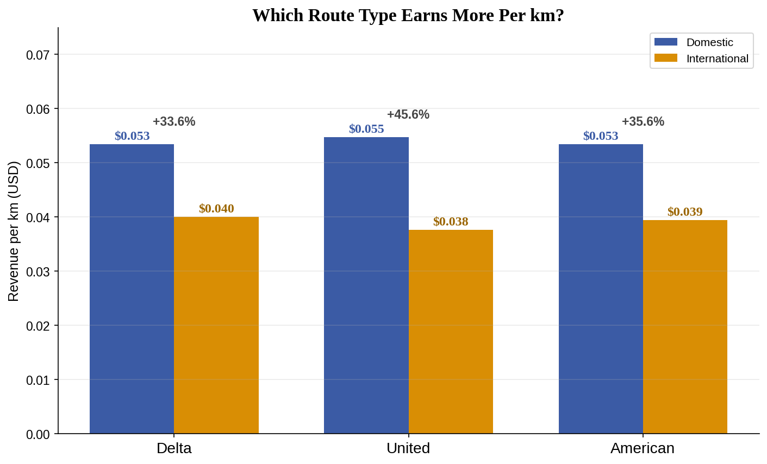
05
HOW — Which Route Type Earns More Per km?
T H E T R A D E - O F F
+33–45%
more revenue per kilometre on domestic routes — for every airline measured.
International wins on volume.
Domestic wins on efficiency.
That is the investment choice.
TAKEAWAY
Domestic routes earn 33–45% more per kilometre than international ones. The biggest routes are not the most efficient — volume and margin are a genuine trade-off.
Notes:
This is the payoff slide. For every airline measured, domestic routes earn 33 to 45 percent more revenue per kilometre than international routes. Combine that with the previous slide: international routes bring in the most total revenue, but domestic routes are far more efficient per unit flown. That is the central trade-off of the whole analysis — volume versus margin. One honest caveat I will flag before anyone asks: I am using fare-per-kilometre as an efficiency proxy, because the dataset contains no route-level cost data. It is directional, not a true profit figure.

Slide 9
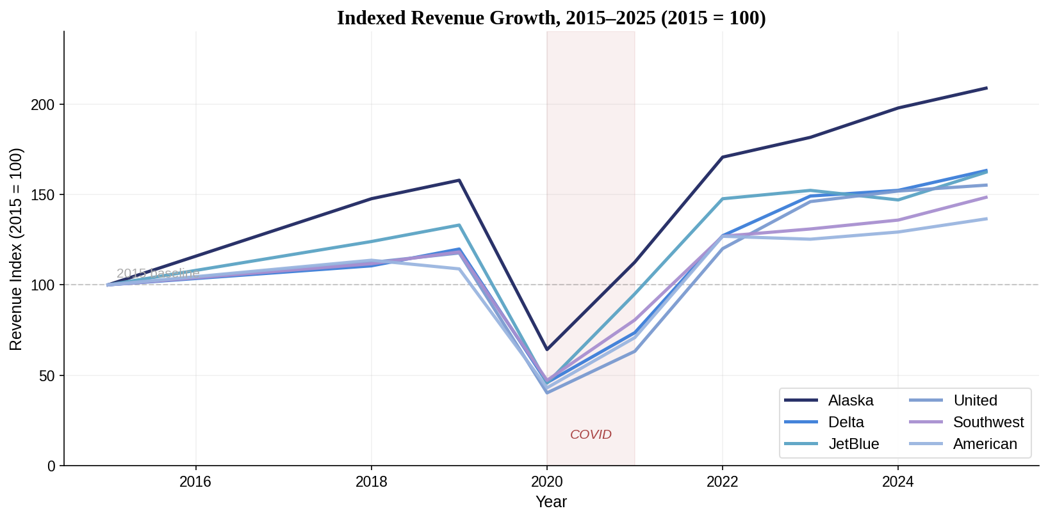
+
Added Bonus — Revenue Growth Rates, 2015–2025
TAKEAWAY
Alaska grew fastest at 7.6% CAGR — doubling revenue since 2015 while larger carriers grew 30–55%. Smallest airline, highest growth rate.

Slide 10
T H E R E C O M M E N D A T I O N
Invest in North America.
THE CORE
THE MARGIN PLAY
Delta Air Lines
Southwest Airlines
$64.7B
11.7%
revenue · largest carrier
operating margin · best in class
THE SURPRISING FIND
Alaska Airlines
Smallest carrier · 7.6% CAGR (fastest) · 8.3% margin · quietly outgrowing the majors
Hold Delta for scale, Southwest for margin — and watch Alaska quietly outgrow them all.
Notes:
So — the recommendation. Region first: North America, proven on size, margin and growth. Then three airlines, each for a different reason. Delta is the core holding: 64.7 billion in revenue, the largest and steadiest of the majors — this is the safe position. Southwest is the margin play: 11.7 percent operating margin, the best in the group, and achieved at real scale rather than as a small niche operator. Alaska is the growth play: compounding at 8.1 percent a year, the fastest in North America, and it rebounded quickest from COVID at 71 percent of baseline by 2021. The overall call: hold Delta for scale, Southwest for margin, weight toward domestic routes for efficiency — and remember from slide three that a downturn is roughly a two-year window, which makes a crash a buying opportunity rather than a permanent loss.

Slide 11
Questions
?
Thank you — happy investing!
Notes:
Thank you — I am happy to take questions on the data, the method, or the recommendation itself.

